Slide 1
Introduction
January 2016
Presented by Dan Keegan
Phone: 312-882-1116
Email: dan@optionthinker.com

Slide 2
More Vertical Spreads
Uneven Butterfly Spreads
Skip Strike Butterfly Spreads
Iron Butterflies
Iron Condors

Slide 3
Uneven Butterfly Spreads
Buy one vertical call spread with a 3.00 strike price differential 20X
Layer the bull spread with a bear spread with a 6.00 strike price differential10X where the short call is the same as the bull spread short call

Slide 4
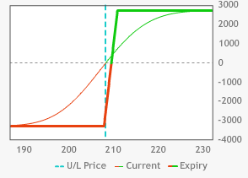
Uneven Butterfly Spreads
Buy 20 SPY Jan 208-211 call spreads @1.66
Max value 3.00 @211
Max profit 1.34 @211 ($2,680)
Min value zero @208 or lower
Max loss 1.66 @208 ($3,320)
Breakeven point @209.66

Slide 5
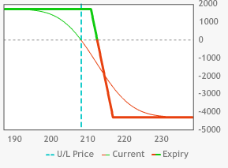
Uneven Butterfly Spreads
Sell 10 SPY Jan 217-211 call spreads @1.70
Max value 6.00 @217
Max loss 4.30 @217 ($4,300)
Min value zero @211 or lower
Max profit 1.70 @211 or lower ($1,700)
Breakeven point @212.70

Slide 6
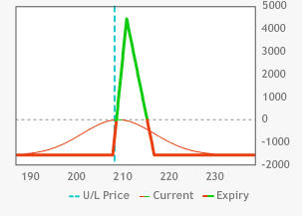
Uneven Butterfly Spreads
Sell10 SPY Jan 217-211 call spreads @1.70
Buy 20 SPY Jan 208-211 call spreads @1.66
Max profit $4,380 @211
Min value zero @208 or lower; @217 or higher
Max loss $1,620 208 or lower; 217 or higher
UBEP 215.38
DBEP 208.81

Slide 7
Skip Strike Butterfly Spreads
Buy one vertical call spread with a 3.00 strike price differential 10X
Layer the bull spread with a bear call spread with a 6.00 strike price differential where the short call is the same as the bull spread short call

Slide 8
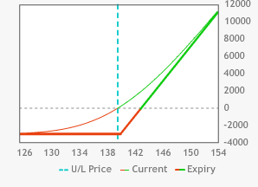
Skip Strike Butterfly Spreads
Buy 10 IBM Jan 140 calls @2.97
Max profit unlimited
Max loss 2.97 9$2,970) @140 or lower
Breakeven point 142.97

Slide 9
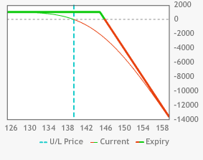
Skip Strike Butterfly Spreads
Sell 10 IBM Jan 145 calls @1.02
Max loss unlimited
Max profit 1.02 ($1,020) @140 or lower
Breakeven point 146.02

Slide 10
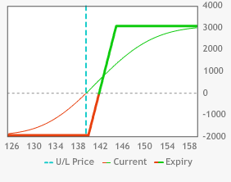
Skip Strike Butterfly Spreads
Buy 10 IBM Jan 140-145 call spreads @1.95
Max value 5.00 @145
Max profit 3.05 ($3,050) @145 or higher
Max loss 1.95 ($1,950) @140 or lower
Breakeven point @141.95

Slide 11
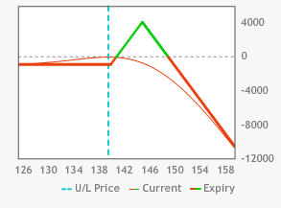
Skip Strike Butterfly Spreads
Buy 10 IBM Jan 140-145 call spreads @1.95
Sell additional 10 Jan 145 calls @1.02
1X2 spread 0.93 debit
Max upside loss unlimited
Max downside loss 0.93 ($930) @140 or lower
Max profit 4.07 ($4,070) @145
DBEP 140.93
UBEP 149.07

Slide 12
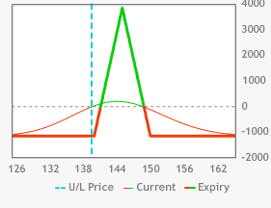
Skip Strike Butterfly Spreads
Buy 10 IBM Jan 140-145 call spreads @1.95
Sell 10 IBM Jan 150-145 call spreads @0.75
Buy 10 IBM Jan 140-145-150 butterflies @1.20
Max value 5.00 @145
Max profit 3.80 ($3,800) @145
Max loss 1.20 @150 or above & 140 or below
Max loss $1,200
DBEP 141.20
UBEP 148.80

Slide 13
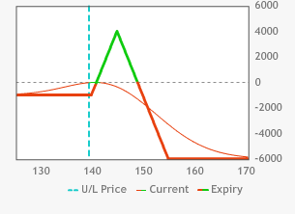
Skip Strike Butterfly Spreads
Buy 10 IBM Jan 140-145 call spreads @1.95
Sell 10 IBM Jan 155-145 call spreads @0.90
Buy 10 IBM Jan 140-145-155 butterflies @1.05
Max profit 3.95 ($3,950) @145
Max downside loss 1.05 ($1,050) @140 or lower
Max upside loss 5.15 ($5,150)
DBEP 141.05
UBEP 149.80

Slide 14
Iron Butterfly Spreads
Sell ATM Straddle
Upside loss unlimited
Downside loss continuous until UV hits zero
Buy strangle to hedge short straddle
Combination results in being short an ATM call vertical in conjunction with being short an ATM put vertical

Slide 15
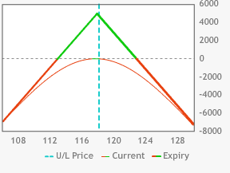
Iron Butterfly Spreads
Sell 10 AAPL Jan 118 straddles @4.92
Max upside loss unlimited
Max downside loss 113.08 @zero
Max profit 4.92 @118
UBEP 122.92
DBEP 113.08

Slide 16
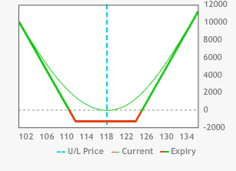
Iron Butterfly Spreads
Buy 10 AAPL Jan 112 put - Jan 124 call strangles @1.28
Max upside profit unlimited
Max downside profit 110.72 @zero
Max loss 1.28 @112-124
UBEP 125.28
DBEP 110.72

Slide 17
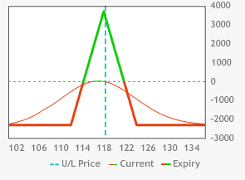
Iron Butterfly Spreads
Buy 10 AAPL Jan 112 put - Jan 124 call strangles @1.28
Sell 10 AAPL Jan 118 straddles @4.92
Iron Butterfly @3.64
Max profit 3.64 @118
Max loss 2.36 ($2,360) 124 & above or 112 & below
UBEP @121.64
DBEP @114.36

Slide 18
Iron Condors
Sell strangle
Unlimited upside loss
Continuous downside loss until UV hits zero
Buy strangle with further out options
Position results in selling equidistant OTM call & put verticals

Slide 19
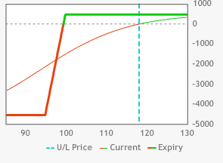
Iron Condors
Sell 10 AAPL Mar 95-100 put spreads @0.45
Max value 5.00 @95
Max loss 4.55 ($4,550) @95 or lower
Min value zero @100 or higher
Max profit 0.45 ($450) @100 or higher
Breakeven @99.55

Slide 20
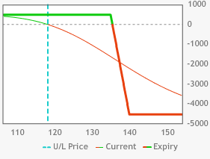
Iron Condors
Sell 10 AAPL Mar 140-135 call spreads @0.46
Max value 5.00 @140
Max loss 4.54 ($4,540) @140 or higher
Min value zero @135 or lower
Max profit 0.46 ($460) @135 or lower
Breakeven @135.46

Slide 21
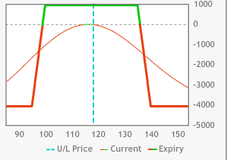
Iron Condors
Sell 10 AAPL Mar 140-135 call spreads @0.46
Sell 10 AAPL Mar 95-100 put spreads @0.45
Iron Condor @0.91
Max loss 4.09 ($4,090) @95 or below & 140 or above
Max profit 0.91 ($910) @100-135
UBEP @135.91
DBEP @99.09

Slide 22
Quiz
1) When you sell 10 FB Feb 120 calls @1.30 & sell 10 FB Feb 85 puts @1.25 you have created a?
short strangle @0.05
short straddle @2.55
short strangle @2.55
short straddle @0.05

Slide 23
Quiz
2) What is the max upside loss in Question #1?
2.55
0.05
unlimited
1.30

Slide 24
Quiz
3) What is the max downside loss in Question #1?
117.45
122.45
82.45
77.45

Slide 25
Quiz
4) What is the max profit in Question #1?
82.45
122.45
2.55
77.45

Slide 26
Quiz
5) What is the DBEP in Question #1?
82.45
127.55
2.55
77.45

Slide 27
Quiz
6) What is the UBEP in Question #1?
1.55
127.55
122.55
77.45

Slide 28
Quiz
7) When you buy 10 FB Feb 125 calls @0.80 & buy 10 FB Feb 80 puts @0.78 you have created a?
long strangle @0.02
long straddle @1.58
long strangle @1.58
long straddle @0.02

Slide 29
Quiz
8) What is the max loss in Question #7?
0.02
3.42
1.58
0.58

Slide 30
Quiz
9) What is the max upside profit in Question #7?
0.02
79.03
125.97
unlimited

Slide 31
Quiz
10) What is the max downside profit in Question #7?
0.02
79.03
125.97
78.42

Slide 32
Quiz
11) What is the UBEP in Question #7?
126.58
79.03
125.97
unlimited

Slide 33
Quiz
12) What is the DBEP in Question #7?
78.42
79.03
125.97
unlimited

Slide 34
Quiz
13) What is called when you combine your short strangle with your long strangle?
iron skillet
iron butterfly
iron condor
iron age

Slide 35
Quiz
14) What is the net premium for the combined trades?
4.03 debit
0.97 credit
4.03 credit
0.97 debit

Slide 36
Quiz
15) What is the max upside loss in Question 13?
4.03
3.42
unlimited
1.58

Slide 37
Quiz
16) What is the max downside loss in Question 13?
4.03
3.42
unlimited
1.58

Slide 38
Quiz
17) What is the DBEP in Question 13?
80.97
84.03
124.03
120.97

Slide 39
Quiz
18) What is the UBEP in Question 13?
80.97
84.03
124.03
120.97

Slide 40
Quiz
19) What is it called when you short 10 FB Jan 103 calls and 10 Jan 103 puts 10X @7.20 ?
short strangle
long strangle
short straddle
long straddle

Slide 41
Quiz
20) What is the max profit for the trade in question 19?
7.20
unlimited
110.20
95.80

Slide 42
Quiz
21) What is the max upside loss for the trade in question 19?
7.20
unlimited
110.20
95.80

Slide 43
Quiz
22) What is the max downside loss for the trade in question 19?
7.20
unlimited
110.20
95.80

Slide 44
Quiz
23) What is the UBEP for the trade in question 19?
7.20
unlimited
110.20
95.80

Slide 45
Quiz
24) What is the DBEP for the trade in question 19?
7.20
unlimited
110.20
95.80

Slide 46
Quiz
25) What is it called when you buy 10 FB Jan 109 calls and buy 10 Jan 97 puts 10X @2.82 ?
short strangle
long strangle
short straddle
long straddle

Slide 47
Quiz
26) What is the max upside profit for the trade in question 25?
2.82
unlimited
110.20
95.80

Slide 48
Quiz
27) What is the max downside profit for the trade in question 25?
7.20
unlimited
110.20
94.18

Slide 49
Quiz
28) What is the max loss for the trade in question 25?
2.82
unlimited
111.82
94.18

Slide 50
Quiz
29) What is the UBEP for the trade in question 25?
7.20
unlimited
111.82
94.18

Slide 51
Quiz
30) What is the DBEP for the trade in question 25?
7.20
unlimited
110.20
94.18

Slide 52
Quiz
31) When you buy 10 FB Jan 97 put- FB Jan 109 call long strangles @2.82 & combine it with 10 FB Jan 103 short straddles @7.20 what have you created?
iron skillet
iron butterfly
iron condor
iron age

Slide 53
Quiz
32) What is the net premium for the position in Question #31?
4.38 debit
11.02 debit
4.38 credit
11.02 credit

Slide 54
Quiz
33) What is the max profit for the position in Question #31?
4.38
2.82
2.62
10.02

Slide 55
Quiz
34) What is the max loss for the position in Question #31?
4.38
1.62
2.82
10.02

Slide 56
Quiz
35) What is the UBEP for the position in Question #31?
107.38
109.00
98.62
97.00

Slide 57
Quiz
36) What is the DBEP for the position in Question #31?
107.38
109.00
98.62
97.00

